Slide 1
Direct Deposit Signup Process
For State Active Duty
In
New York State

Slide 2
All persons who are placed on State Active Duty in a pay status are required to have their paychecks sent by direct deposit to a bank or credit union of their choice.
For each new mission, this process must be completed.

Slide 3
Fill out form AC 2772
Direct Deposit for NYS Employees
The form can be found on the NY Naval Militia website at:
http://dmna.ny.gov/forms/naval/AC_2772_Direct_Deposit_Form_for_NYS_Employees.pdf
Complete sections A, B, and D.
Include a copy of a voided check like this:

Slide 4
If two persons are listed on the check (a joint account), then both persons must sign in Section D of the Direct Deposit Form.

Slide 5
Alternatively, you may go to MYPAY
All Reservists and Retirees have a MYPAY account.
Use this method if you do not have paper checks available.

Slide 6
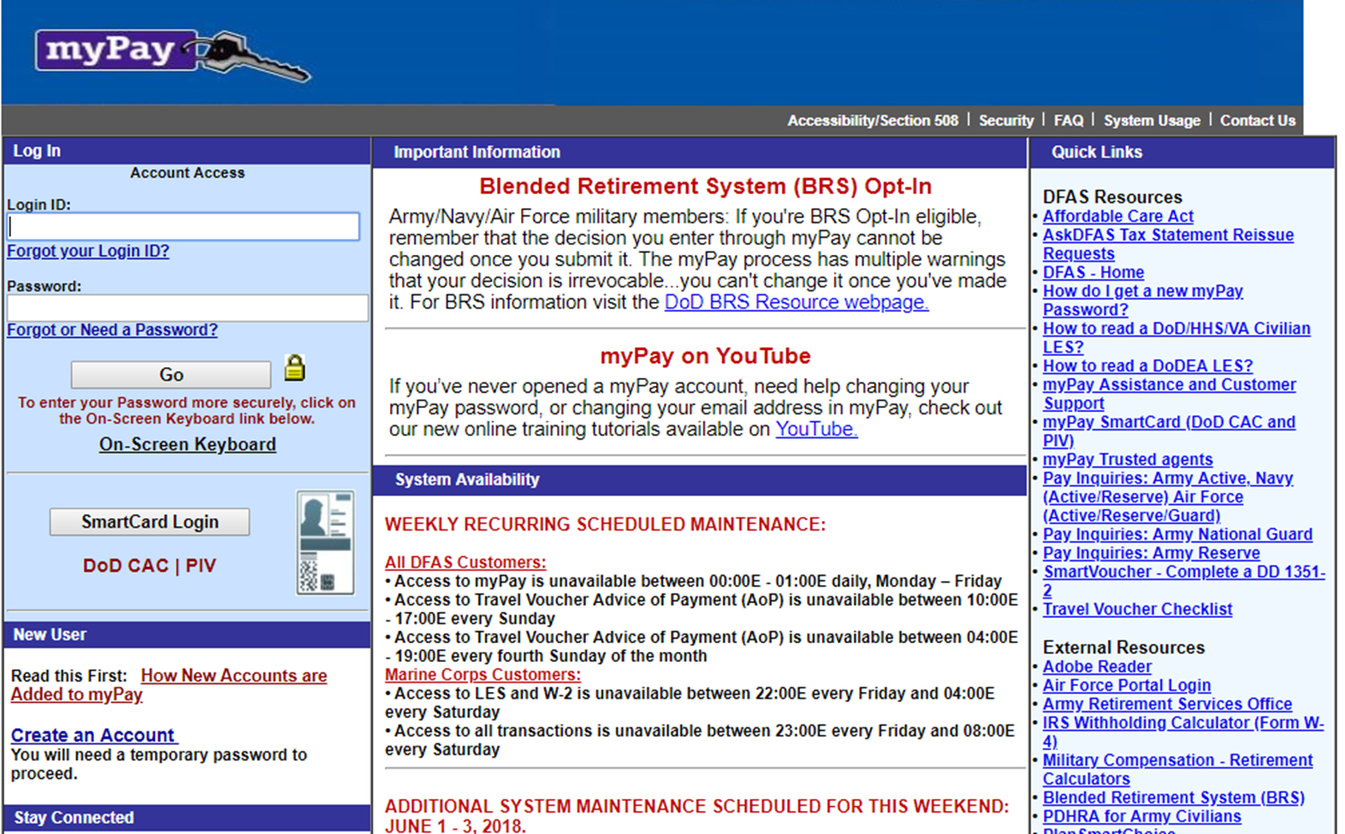
Go to MYPAY at https://mypay.dfas.mil/mypay.aspx
Log in with ID and password, or Common Access Card (CAC).

Slide 7
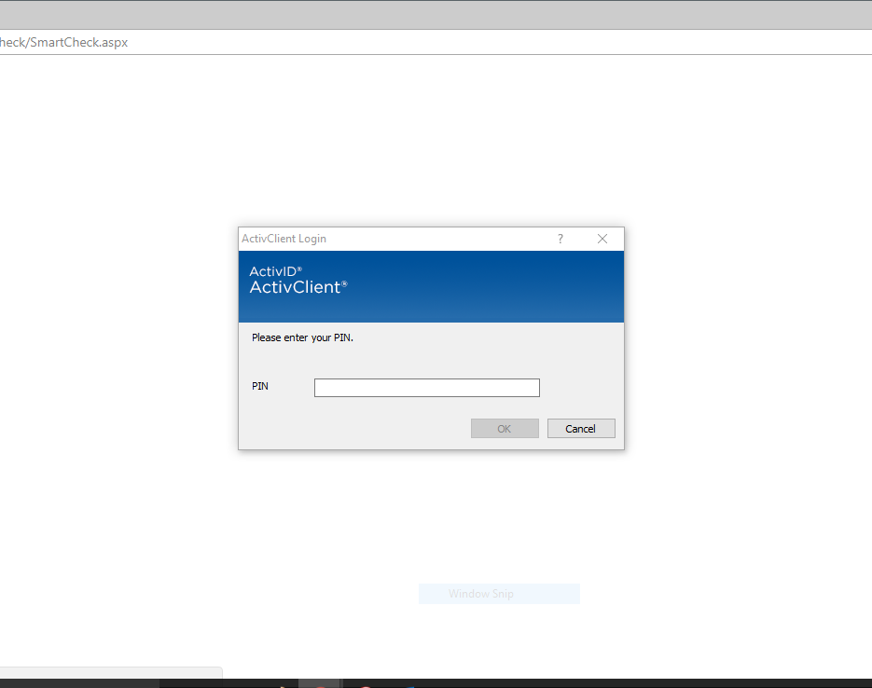
Enter your MYPAY PIN

Slide 8
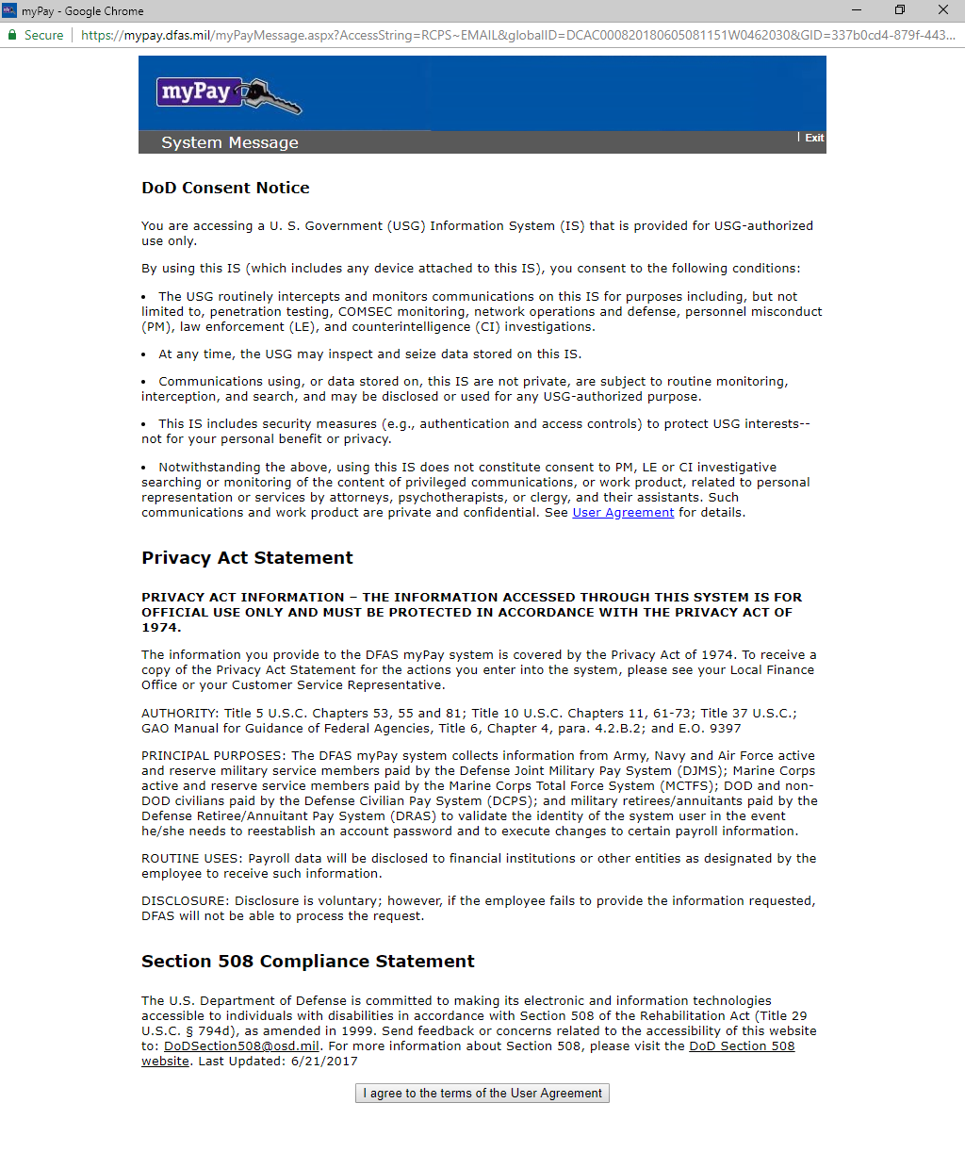
Acknowledge CONSENT at the bottom of this page.

Slide 9
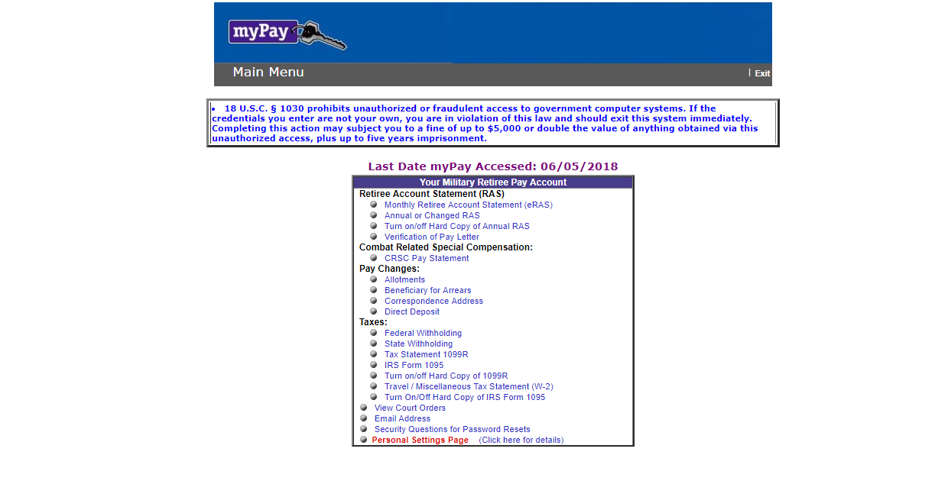
Choose DIRECT DEPOSIT from the menu under PAY CHANGES

Slide 10
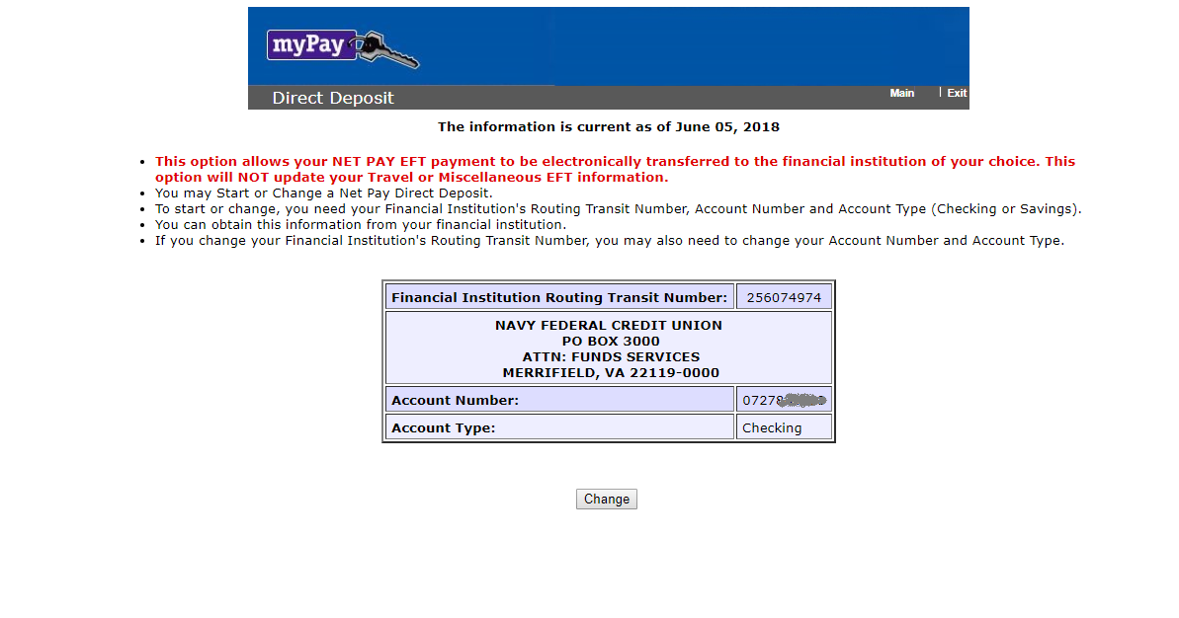
This is the needed information to be submitted along with your direct deposit form.
Take a screen shot of this, print out, and submit.

