Slide 1
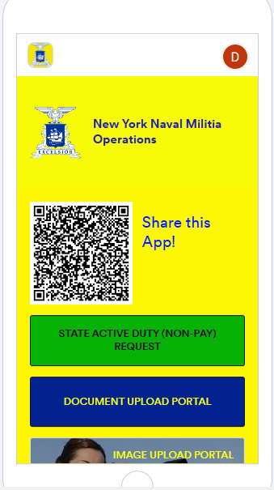
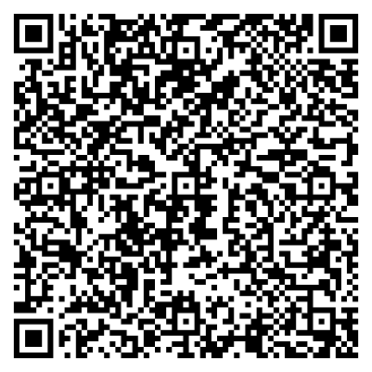
How to request SAD orders

Slide 2
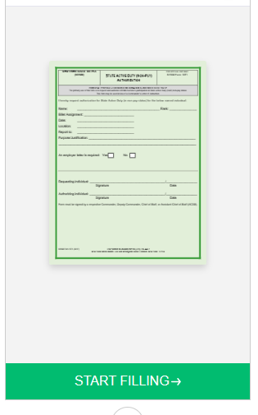

Select State Active Duty Request

Slide 3
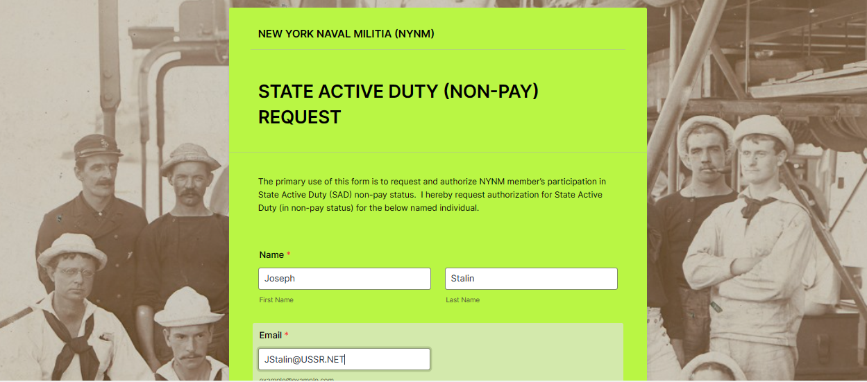
Start adding information

Slide 4
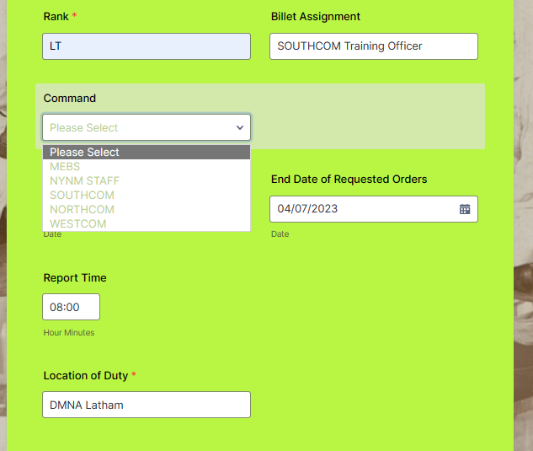
Select your correct command for orders:
If you are in MEBS, select “MEBS” for MEBS orders only, not your regional command.
If you are NYNM HQ Staff, including as a Region Commander, select NYNM Staff
All others, select your region

Slide 5
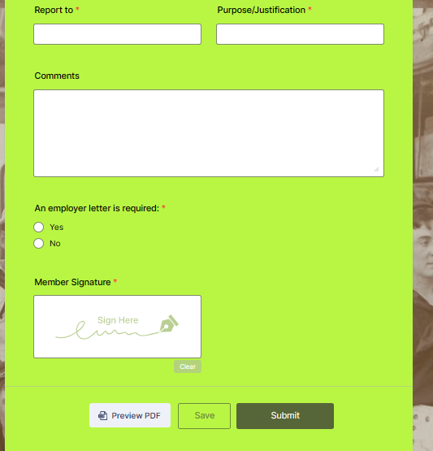
The last part before submitting….

Slide 6
What happens next?
Depending on which command you select, your request will get routed to the approval authority:
  MEBS to MEBS CDR (for MEBS events and MEBS travel funds)
  NYNM STAFF to NYNM CoS (for NYNM events and travel funds)
  Regions to Regional Commander (for non-MEBS events and non-MEBS travel funds)
If funding is requested and recommended for approval, the process adds the Executive Officer as an additional approver for travel authorization.
So, the net result of the SAD request could be one of three options:
  Not approved for orders. The request does not get forwarded to the order-writers. Member is notified by email.
  Approved for orders with travel funding authorized. Request is forwarded to the NYNM Mailbox for order-writing.
  Approved for orders without travel funding authorized. Request is forwarded to the NYNM for order-writing.

Slide 7
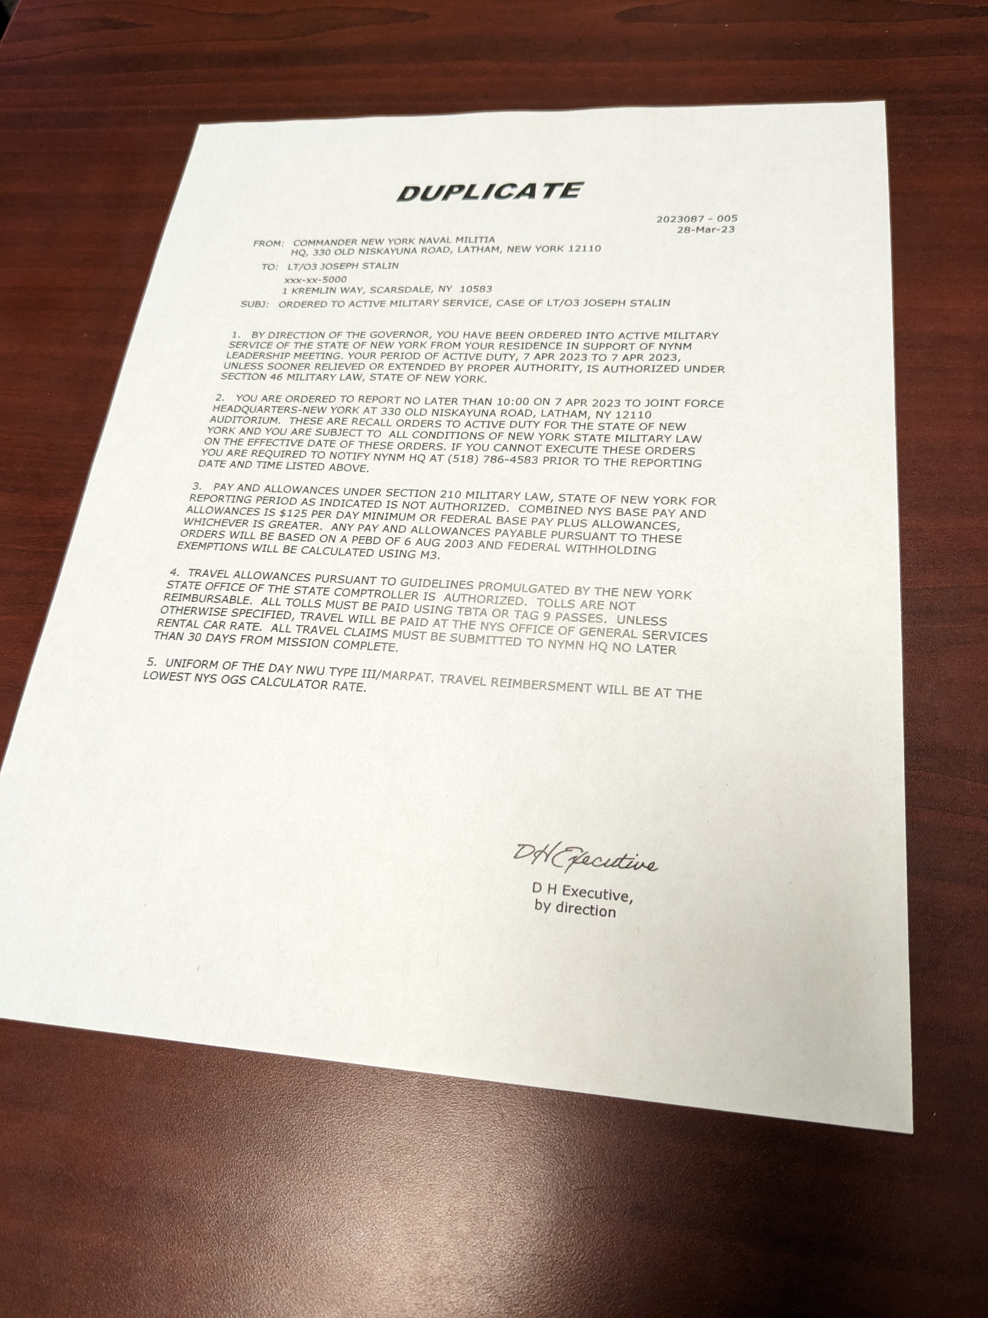
Finally, your orders!

