Slide 1
DON’T LET YOUR “GUARD” DOWN
SMALL BOAT TRAILERING AND TOWING
Provided by:
Health, Safety & Work-Life
Service Center
Norfolk, VA
10/18/10

Slide 2
References & Guidelines
Non-Standard Boat Operator’s Handbook
COMDTINST 16114.28
Small Boat Trailering and Towing Comprehensive PQS
EZ Loader Owner’s Manual

Slide 3
PURPOSE
This program is designed to cover basic safety principles in coupling, towing, launching, and recovering of trailerable small boats.
To try and reduce the amount of trailering and towing mishaps.

Slide 4
INTRODUCTION
In this session you will learn:
Trailering and towing basics
Nomenclature
Proper coupling of trailer to tow vehicle
Proper trailer safety check offs
Towing safety
Proper launch sequence
Proper recovery sequence
Roadside safety rules in the event of a breakdown

Slide 5
Definitions
Coupling (link)- to fasten together a trailer and tow vehicle
Towing (haul) - to draw or pull along behind-the act of launching and recovering a boat
Spotter – A safety observer who advises the driver of clearances above, behind, below and on both sides of the rig when backing up or when clearances are tight. The driver is responsible for posting spotters.

Slide 6
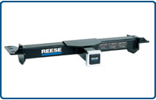
Hitch/Receiver
Mounted to the trucks frame, the receiver/hitch couples the drawbar

Slide 7
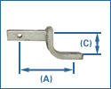
Drawbar and Hitch Ball
The drawbar slides into the receiver where it is coupled by a pin.
The hitch ball is attached to the opposite end of the drawbar by a lock nut and washer.

Slide 8
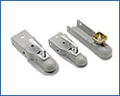
Tongue Coupler
Located on the tongue of the trailer, the coupler locking mechanism must be secure.
In most situations this is accomplished with a latch pin or pad lock.

Slide 9
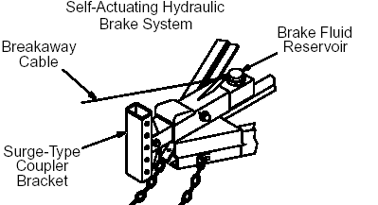
Brake System
Self-actuating Hydraulic Break System: Trailer tongue serves as “break pedal” so that when the tow vehicle slows down the actuator is depressed causing the trailer to apply the brakes. (A.K.A Hydraulic Surge) the breakaway cable acts as an emergency brake in the event of a separation.

Slide 10
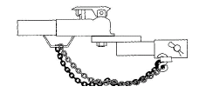
Safety Chains
The safety chains are attached crisscrossing under the coupler to the frame of the tow vehicle. If the ball were to break, the trailer would follow in a straight line and prevent the coupler from dragging on the road.

Slide 11
Trailering Limits
Without a special permit, the widest boat that can be trailered on most state roads is eight feet.
On most roads with twelve-foot lanes, the maximum width is 8.5 feet. These widths include both the boat and the trailer.
Ref (a) 6.C.1

Slide 12
Capacity Rating
Should be greater than the combined basic weight of the boat, engines, and equipment (including fuel).
Federal law requires that all trailers have certain important capacity information displayed.

Slide 13
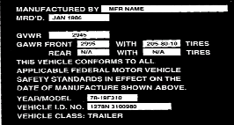
Capacity Label

Slide 14
Weight Ratings
Gross Vehicle Weight Rating (GVWR): the trailer and all weight it is expected to carry.
Gross Axle Weight Rating (GAWR): specifies the proper tires needed to carry the load for which the trailer is rated.
On multi-axle trailers, the combined GAWR of all axles must be equal to or greater than the GVWR for the trailer.

Slide 15
Weight Ratings (cont.)
Gross Vehicle (Trailer) Weight (GVW/GTW): total weight of boat, trailer, and all equipment carried on board.
Be sure that the GVW does not exceed GVWR.
Tongue Weight: difference between GVW and GAW.

Slide 16
Hitches
Two basic types:
Weight carrying hitch and
Weight distribution (load equalizer) hitch: designed to spread the tongue weight to both the front and rear wheels of the tow vehicle.

Slide 17
Hitch Classes
There are four hitch classes based on weight capacity:
Class I less than 2000 lbs
Class II less than 3500 lbs (frame mounted)
Class III less than 5000 lbs
Class IV up to 10000 lbs

Slide 18
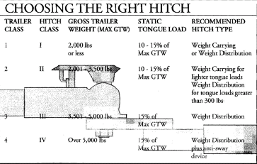
Ref (a)Fig. 6-16

Slide 19
Trailering the Boat
When transported on a trailer, the boat should be supported structurally as evenly across the hull as possible.
This allows for even weight distribution.
The capacity of the trailer should be greater than the total weight of the boat engines and equipment.

Slide 20
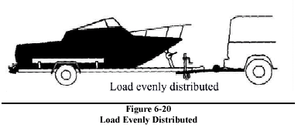
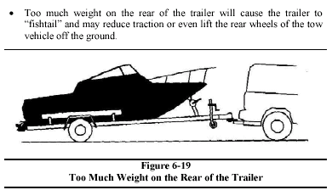
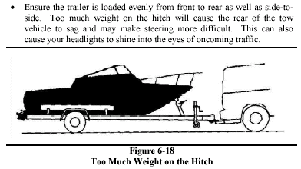
Proper/Improper Weight Distribution
RIGHT
WRONG WRONG

Slide 21
Tow Vehicle
The tow vehicle must be capable of handling GTW plus the weight of the passengers and equipment carried inside the vehicle.
Vehicle may have to be equipped with:
Engine of adequate power
Transmission and rear-end designed for towing
Larger cooling systems for the engine and transmission
Heavy duty brakes
Load bearing hitch attached to the frame, not the bumper

Slide 22
Tie-Downs
Tie-downs and lower unit supports must be adjusted properly to prevent the boat from bouncing on the trailer.
The bow eye on the boat should be be secured with a rope, chain, or turnbuckle in addition to the winch cable.
Additional straps may be required across the beam of the boat.

Slide 23
Pretrailering Checklist
Ensure the tow ball and coupler are the same size and bolts with washers are tightly secured.
Confirm coupler is completely over the ball and latching mechanism is locked down in place.
Ensure safety chains are attached, crisscrossing under the coupler to the frame of the tow vehicle.
Ensure breakaway cable is attached to tow vehicle.
Ensure coupler latch pin/lock is properly secured in coupler latch.

Slide 24
Pretrailering Checklist cont.
Check all lights and signals on trailer to ensure proper function.
Check the brakes and brake fluid level.
Adjust mirrors.
Check tires including spare and wheel bearings.

Slide 25
Pre-trailering Checklist cont.
Ensure the trailer is loaded evenly from front to rear as well as side-to-side.
Ensure contents of boat are tied down.
Ensure all tie downs are properly adjusted.
Ensure safety chain is attached to bow nose and winch is in the locked position.

Slide 26
Towing Precautions
More time is required to brake, accelerate, pass, and stop.
The turn radius is increased.
Prior to operating on the open road, a new operator will be required to demonstrate proper turning, backing up, and other maneuvers in an area similar to the trailer’s normal operating environment.

Slide 27
Towing Precautions cont.
Allow two vehicle lengths per 10 mph b/w you & the vehicle ahead of you.
Become familiar with your state’s highway and traffic laws for towing a trailer.

Slide 28
Launching Sequence
Check the boat to insure that no damage was caused during the trip
Raise lower unit of outdrive so as not to strike bottom while backing in water
Secure drain plug
Ensure winch is in locked position and keeper chain is attached to bow eye.
Remove tie downs

Slide 29
Launching Sequence cont.
Disconnect trailer lights to prevent shorting of electrical system or bulb burnout.
Attach lines to bow and stern so boat can be manipulated upon launching.
Visually inspect launch ramp for hazards such as steep drop off, slippery areas, sharp objects, underway obstacles (boulders, potholes, and lines)

Slide 30
Launching Sequence cont
Lock-out trailer brake actuator.
After everything has been double checked, post spotter and proceed down ramp.
Be sure to keep the rear wheels out of the water to prevent the exhaust from submerging and possibly stalling the engine
Set parking brake and place chocks under front wheels
Place someone on the dock to hold the bow line

Slide 31
Launching Sequence (cont.)
Once in the water, lower engines and prepare to start them
Start engine and ensure water is passing through the cooling system
Release bow safety chain and winch
At this point you can launch the boat with a push or under slight power.

Slide 32
Proper Recovery Sequence
Post spotter for driver and position trailer on boat ramp for recovery of small boat
Attach line to bow that may be tossed to recovery crew in event of loss of power
Secure boat to trailer via winch cable and keeper chain to bow eye. Ensure winch is in locked position.
Secure engine and trim up outdrive

Slide 33
Proper Recovery Sequence Cont.
Carefully remove boat from water and away from boat ramp so others can launch/recover.
Remove boat plugs
Connect trailer lights
Secure boat to trailer with tiedown straps and cradle outdrive with transom saver

Slide 34
Proper Recovery Sequence Cont.
Perform trailer light checks
Inspect prop, outdrive, hull, and boat trailer wheels/axle for any damage. Give extra attention to wheel bearing area ensuring covers are in place and tires are properly inflated.
Inspect safety chains, ensure coupler latch pin is properly secured in coupler latch, and reattach breakaway cable to tow vehicle.
Ensure all gear in boat is secure. Double check everything prior to departing.

Slide 35
Warnings and Precautions
If care and maintenance are neglected, you may be endangering the safety of your boat, your vehicle, your crew, yourself and the public.
Check all lights and signals prior to departing unit and again prior to departing launch ramp.
Do not tow any trailer faster than 55 mph.

Slide 36
Warnings and Precautions cont.
Check tires and wheel bearings prior to departing unit and launch ramp.
Ensure the trailer is loaded evenly from front to rear as well as side-to-side.
Passing is never recommended.

Slide 37
Warnings and Precautions cont.
It is unsafe to stand on the tongue of the trailer or stand in the boat unbraced when it is being backed down or driven up the boat ramp.
Never allow a person to stand in the line of the winch cable when it is loaded or taut.

Slide 38
Roadside Safety Rules in the Event of a Breakdown
Should you break down on the road, there are steps you should take to insure your safety in what can be a very dangerous situation.
Make sure you and your rig are as visible as possible to passing motorists.
Day or night, always use your emergency flashers. Switch them on before coming to a stop

Slide 39
Roadside Safety Rules in the Event of a Breakdown cont.
Jackknife your rig to insure that the outer taillight of your tow vehicle is un-obscured by the boat and is visible to oncoming traffic. This will maximize visibility of your rig and encourage passing motorists to give you a wider berth.
Set out a road flare approximately 100 yards behind your rig.

Slide 40
Roadside Safety Rules in the Event of a Breakdown cont.
If repairs cannot be expedited in a timely manner, chock trailer wheels, uncouple trailer and position tow vehicle two to three car lengths behind trailer. This will:
Provide a protective barrier between you and oncoming traffic
Allow illumination with headlights during night repairs

Slide 41
Roadside Safety Rules in the Event of a Breakdown cont
The tow vehicle must be unoccupied during this time.
Any good Samaritan should position his vehicle the same distance behind you.
Post one person as a lookout while repairs are being conducted.*

Slide 42
Summary
This training should be used as a guideline and is not intended to cover all situations or events.
In such cases, common-sense and good practical judgment should prevail always emphasizing safety to the public, your crew, yourself and your rig.
Remember! Safety is everyone’s responsibility!

